Slide 1
Tips and Tricks for working with Finance Data in Power BI
Rishi Sapra | Chartered Accountant (ACA) | Microsoft MVP

Slide 2














Rishi Sapra
Rishi Sapra
rsaprano

Slide 3
Basic Financial Reporting in Excel
DEMO

Slide 4

Tip #1: Use an account hierarchy

Slide 5
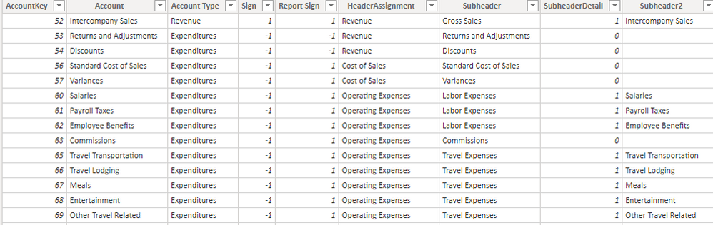
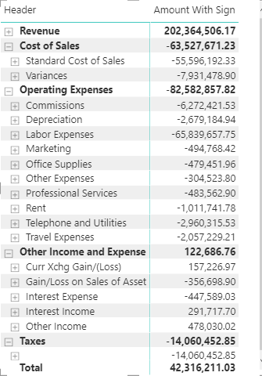
Dimension Table with an Account Hierarchy fits a matrix visual perfectly!

Slide 6
Tip #2: Build up Measure Chains and format them

Slide 7
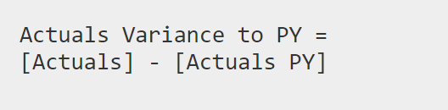
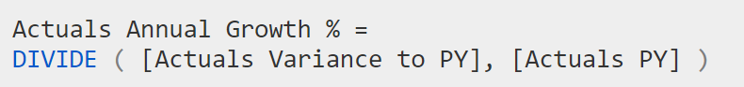
Start with Simple SUMs and then modify the filter context
Example Custom Format String (Borrowed from Excel, entered in the Modelling tab in Power BI)
"£"#,0;("£"#,0);"£"#,0

Slide 8
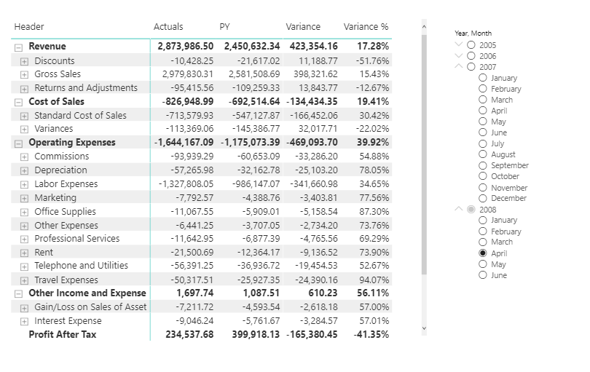
The Matrix is getting there…

Slide 9
Tip #3: Show Periods (MTD/QTD/YTD) dynamically

Slide 10
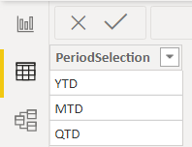
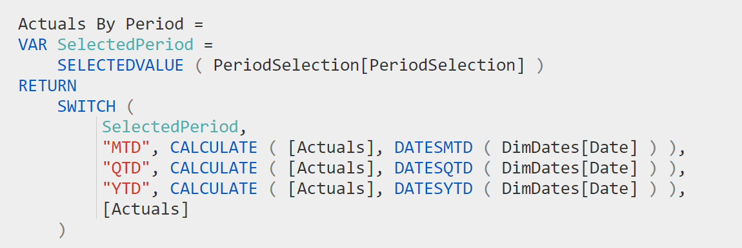
Dynamic Time Period Measure for Actuals

Slide 11
Tip #4: Have a table with all your FS lines (including totals)

Slide 12
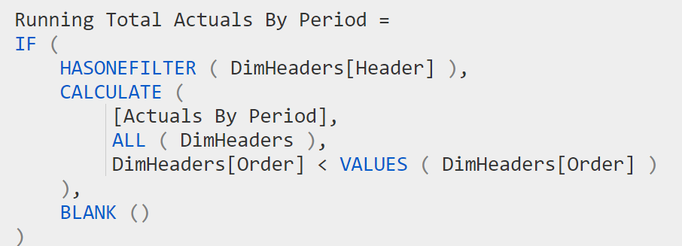
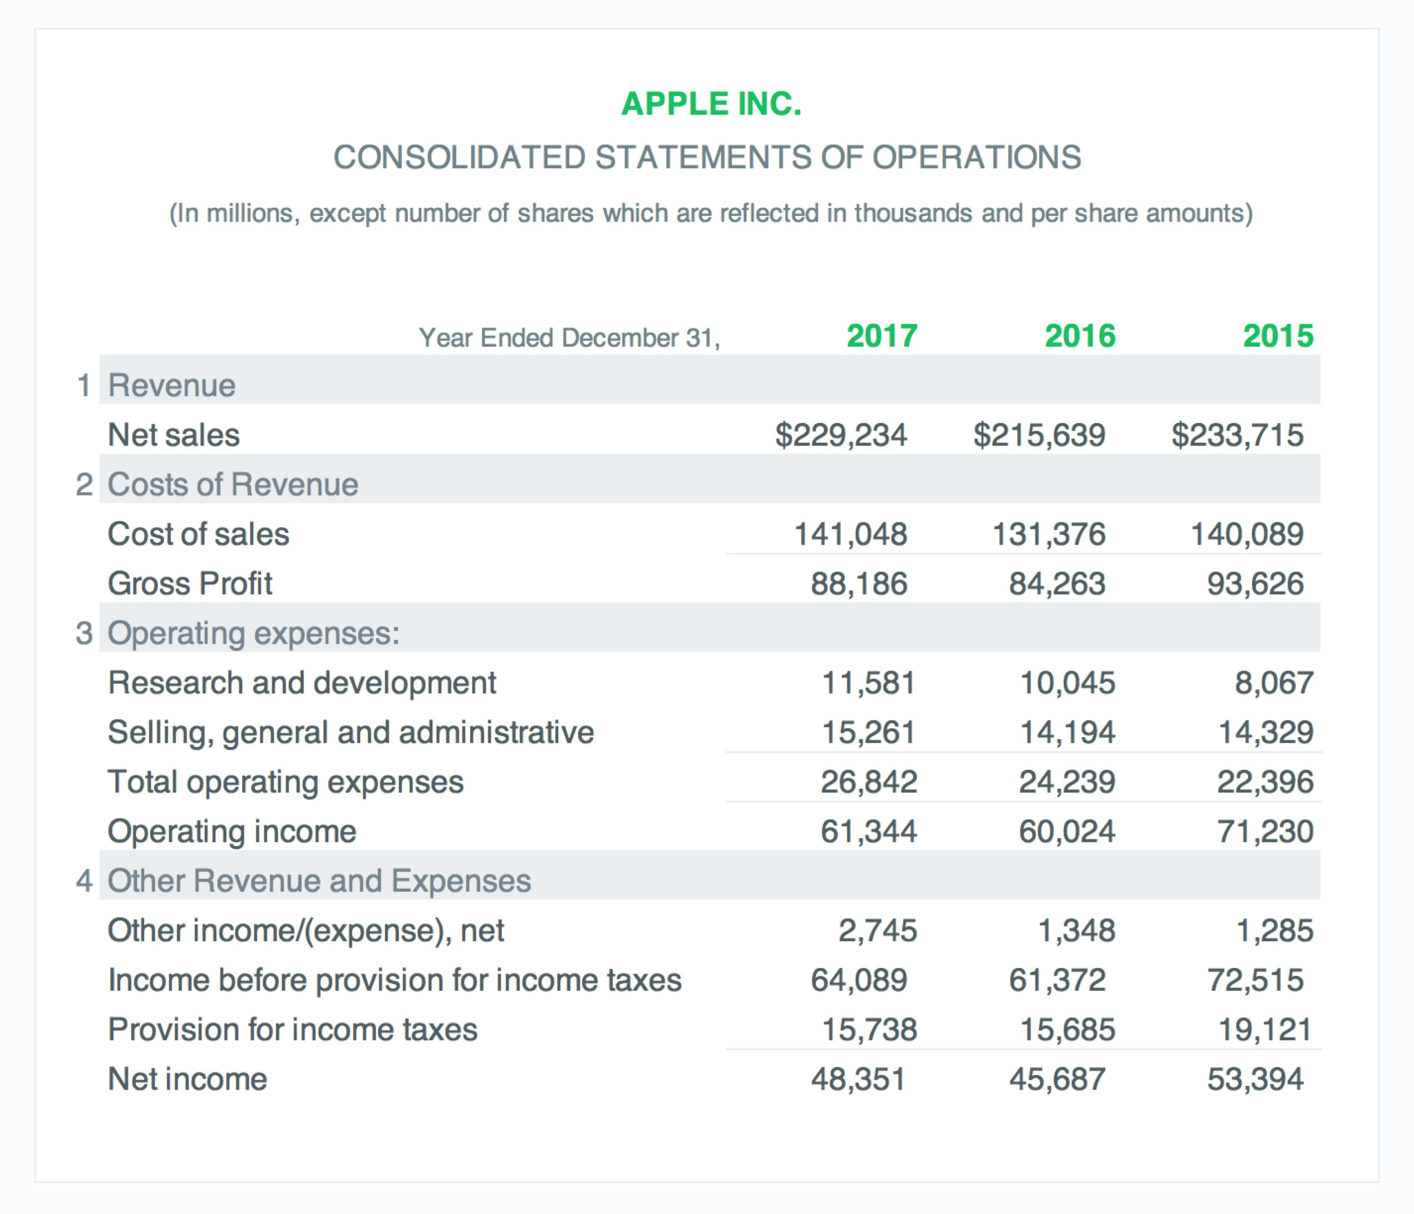
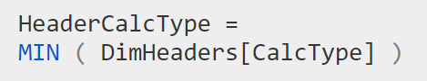
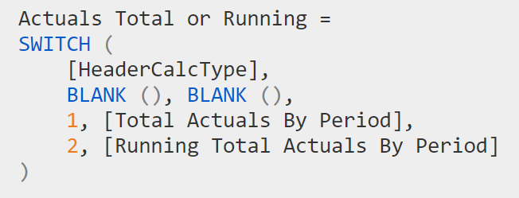
Real Income Statements have Sub-totals

Slide 13
Tip #5: Tell a story with the visuals

Slide 14
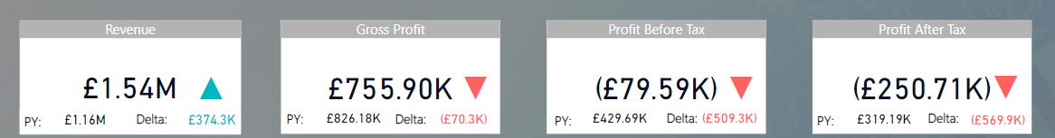
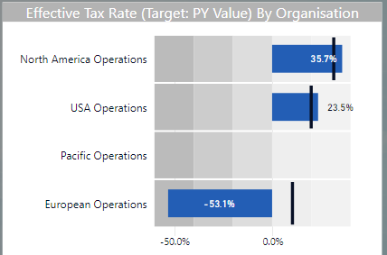
Provide context to numbers: Highlight Clearly whether they’re good or bad!

Slide 15
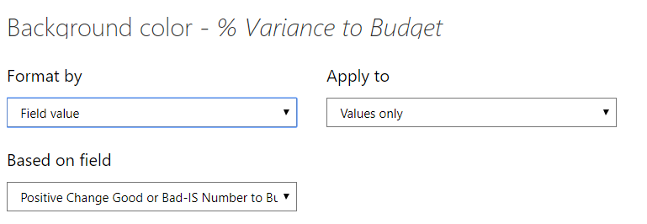
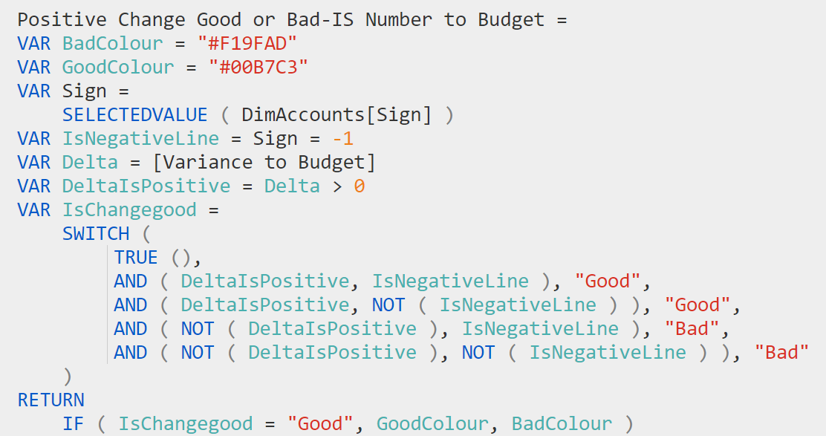
Use Colour (e.g. Conditional Formatting) sparingly and to draw attention

Slide 16
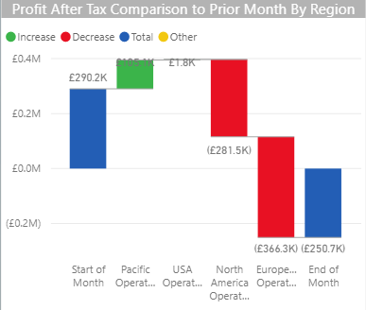
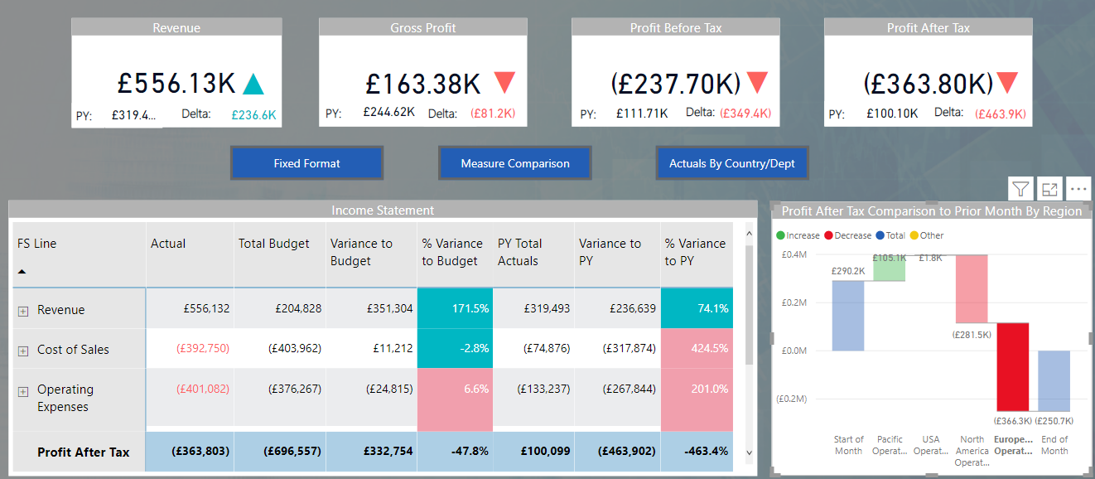
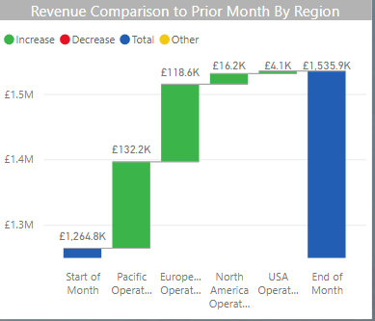
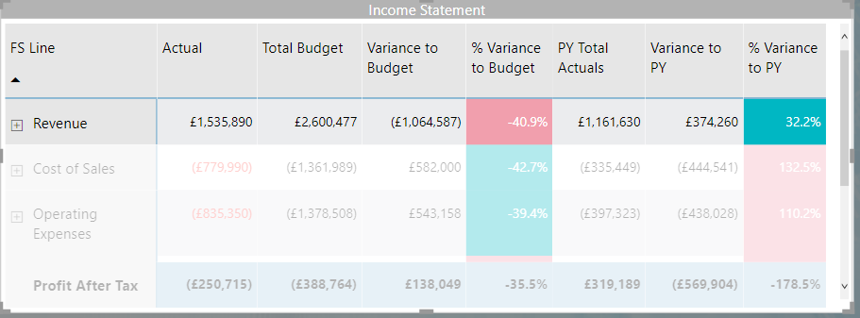
Let the users ask ‘Why’ through visual interactions (and drill-through/drill-down)
Whole page filters for Region
Waterfall chart shows comparison for Revenue

Slide 17
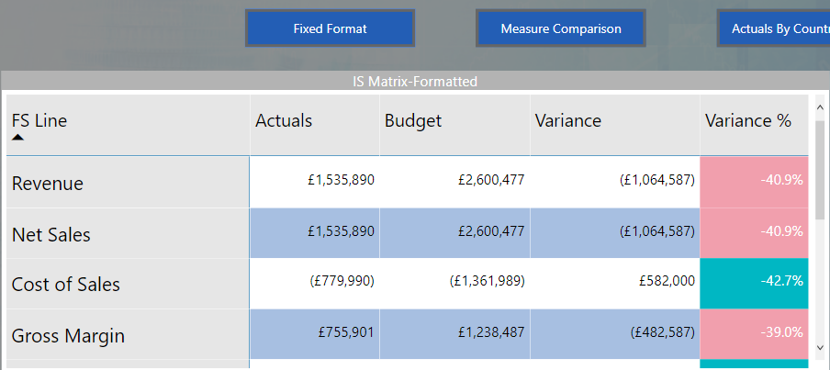
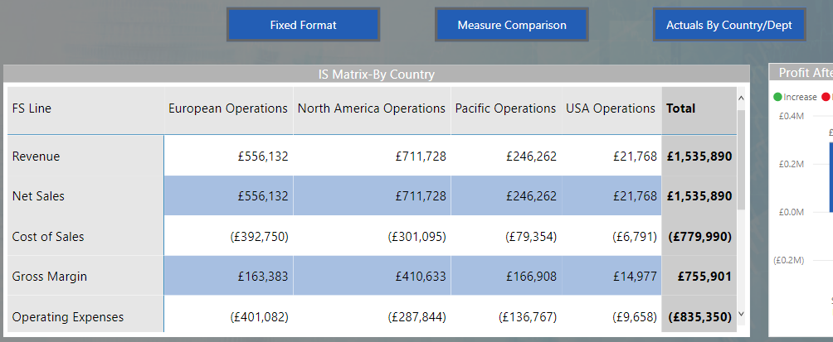
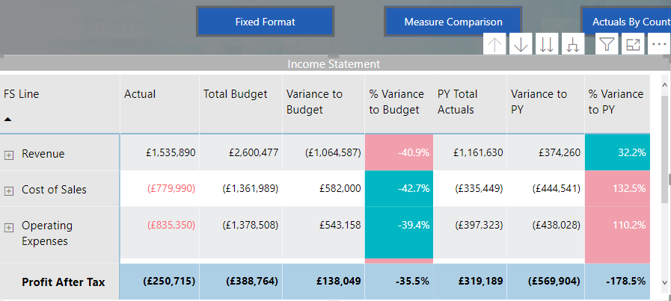
Consider Using Bookmarks to aid the user experience

Slide 18
Tip #6: Finance Custom Visuals/Add-ins go a long way

Slide 19
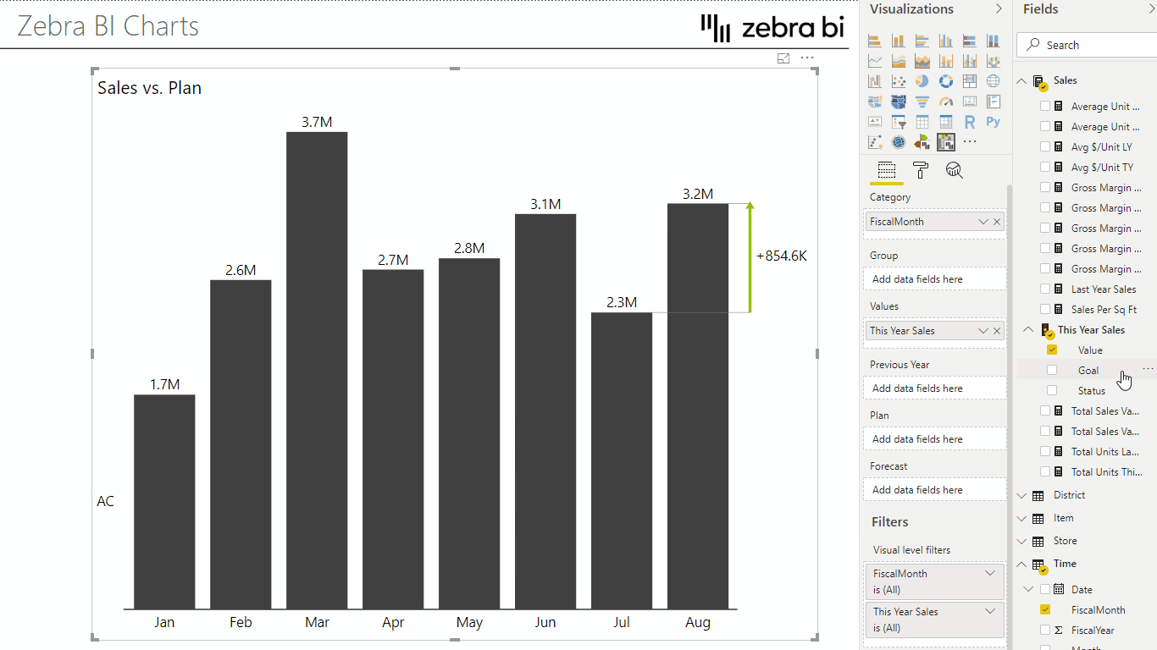
Zebra BI
See the webinar at www.powerplatformfinance.com

Slide 20
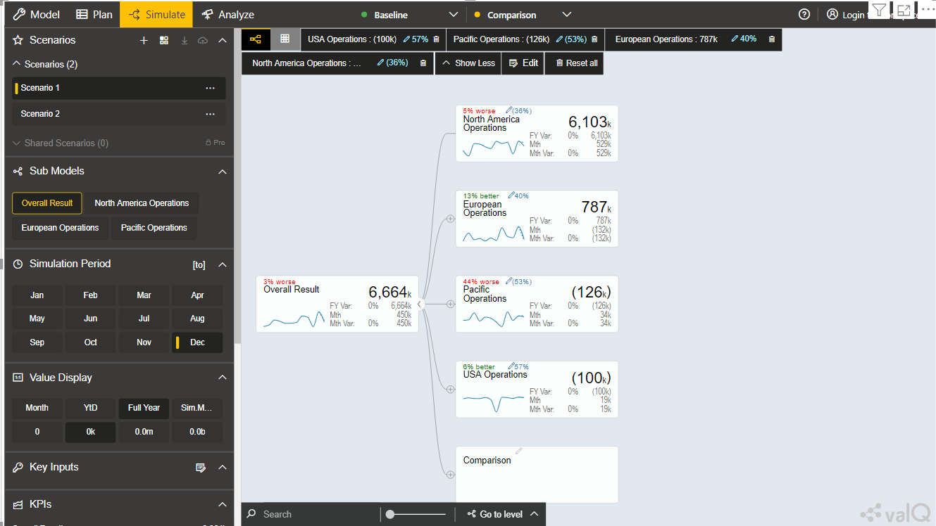
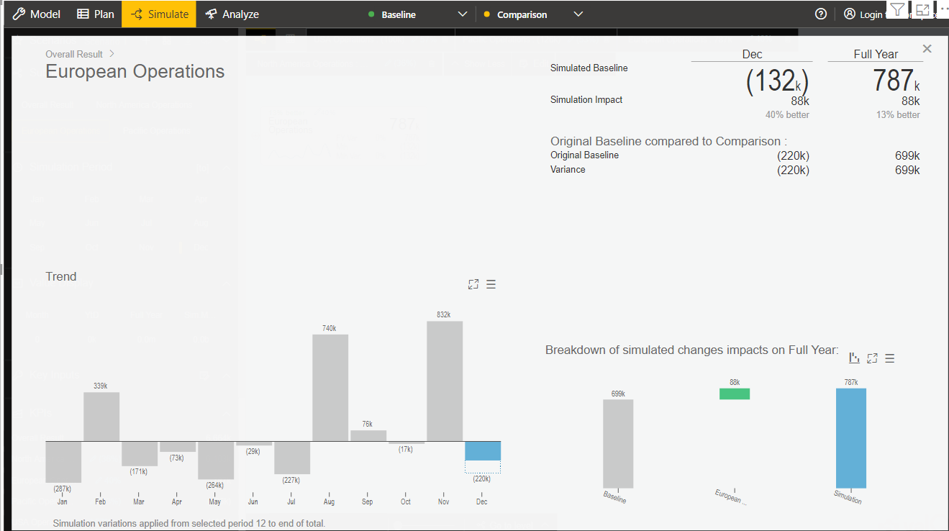
ValQ
See the webinar at www.powerplatformfinance.com

Slide 21
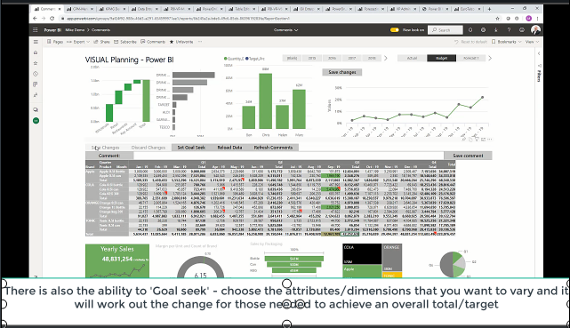
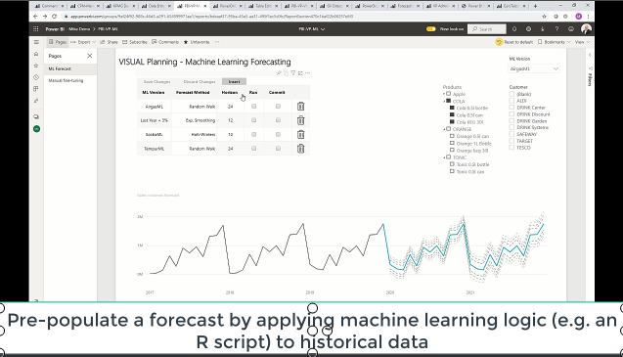
Power On BI
See the webinar at www.powerplatformfinance.com

Slide 22
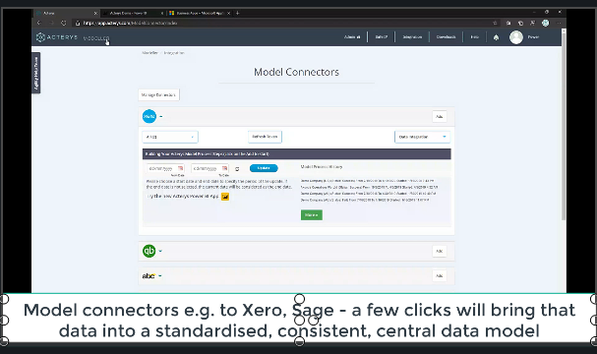
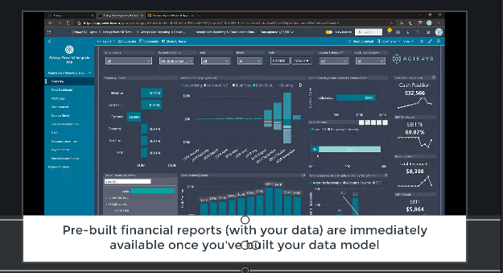
Acterys
See the webinar at www.powerplatformfinance.com

Slide 23
Summary

Slide 24
Summary of Key Points
Tip #1: Use an Account Hierarchy
Tip #2: Build up Measure Chains and Format them
Tip #3: Show Periods (MTD/QTD/YTD) dynamically
Tip #4: Have a table with all your FS lines (including totals)
Tip #5: Tell a story with the visuals
Tip #6: Finance Custom Visuals/Add-ins go a long way

Slide 25
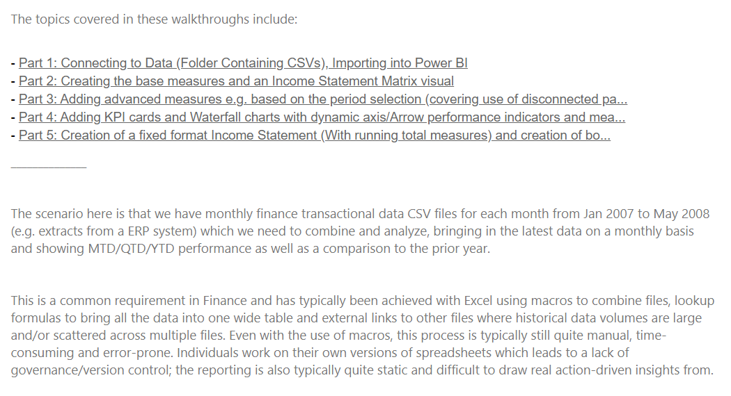
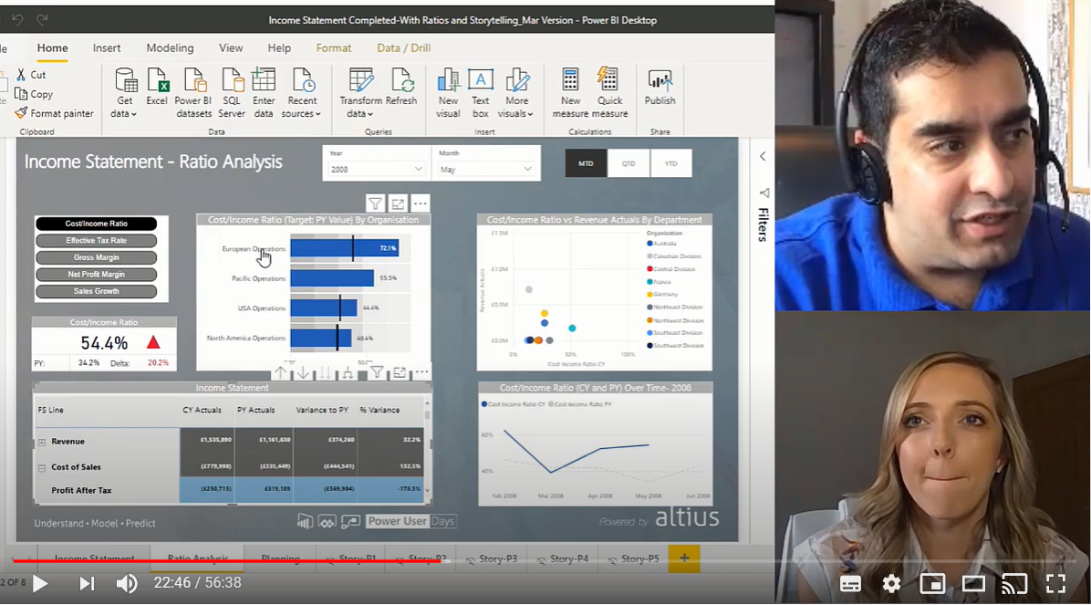
Where can I download the examples from?
Aka.ms/pbiincomestatement
Tinyurl.com/PPFroleplay

Slide 26
Questions?

Slide 27
Thank you!

